Slide 1

Future Performance Tool
Seb Fox
Senior Data Scientist
SW Decision Support Network
Notes:
I am contracted to BNSSG ICB

Slide 2
Project brief
Predict NHS performance metrics from demand and capacity metrics at ICS geography
Provide a tool for decision makers in the SW can interact with and develop future scenarios

Slide 3
My constraints
Data access – I don’t have access to local datasets; use public data
Local variation in capabilities – I can’t expect them to be able to understand a big bundle of code and use it locally; provide an application with minimal skills to use
Local variation in technologies – not all teams will be able to deploy an application I develop locally; deploy a tool publically
Limited support period – I am on secondment for 2 years, if teams like this work, it needs to be supported beyond my stay; make reproducible

Slide 4
Topics
Reproducibility
Data
Methods
Implementation

Slide 5
Reproducibility
Reproducibility
Open source programming software
Coding in the open (using Git/GitHub)
Documented code
Standard project structures
Controlling the analytical/package environment {renv}
Data
Methods
Implementation

Slide 6

Open source
Reproducibility
Anyone can use it (not limited to operating system or budgets etc)
Every step is programmed – there are no manual steps; nothing is hidden
I used R
Data
Methods
Implementation

Slide 7
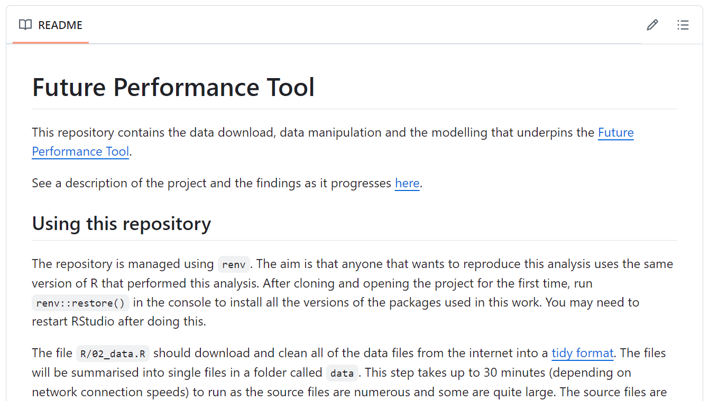
Coding in the open
Reproducibility
GitHub for analysis: https://github.com/nhs-bnssg-analytics/d_and_c
GitHub for tool: https://github.com/nhs-bnssg-analytics/shiny_planner
Instructions in the README for how to reuse the code
Data
Methods
Implementation

Slide 8
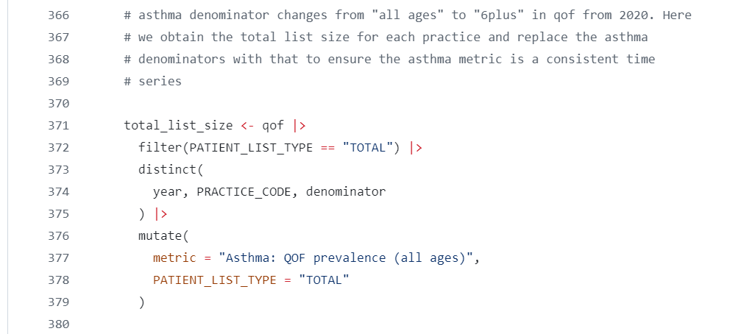
Documented code
Reproducibility
Helps the users that want more detail (and future me!) on the steps taken
Data
Methods
Implementation

Slide 9
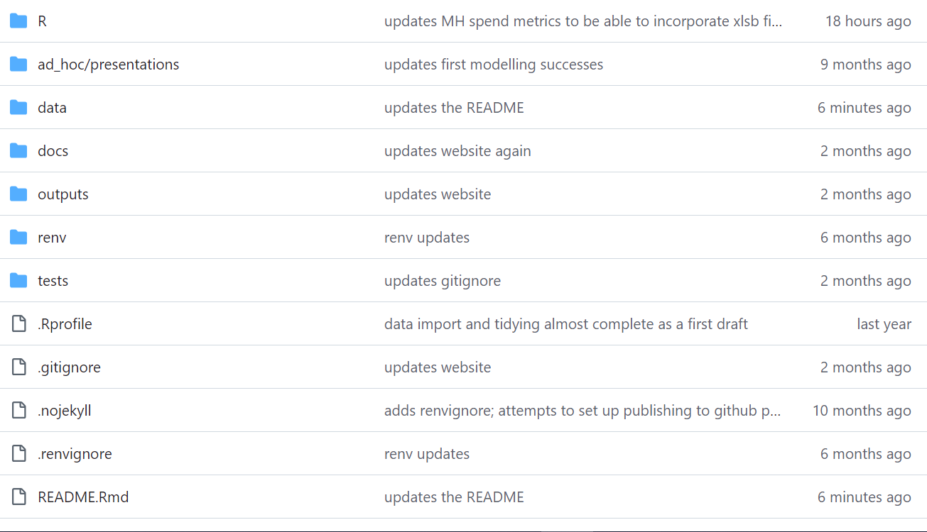
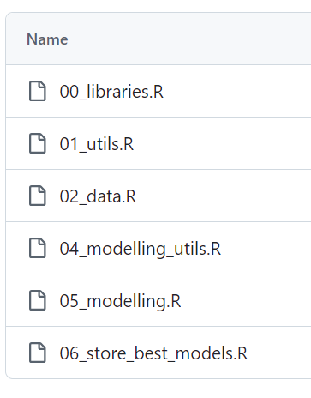
Standard project structures and naming
Reproducibility
Standard structure help users navigate repositories more easily
Data
Methods
Implementation

Slide 10
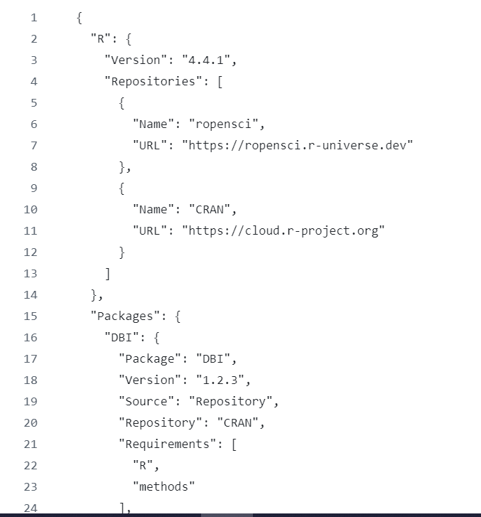
Controlling the analytical environment
Reproducibility
Aids preventing the conversation “why does it work on yours but not on mine?”
{renv} is an R package which (sometimes) seamlessly does this
init()
snapshot()
restore()
Data
automatically generated renv.lock file!
Methods
Implementation

Slide 11
Data
Reproducibility
All public data (on the web)
Challenges
Frequency of production (daily, monthly, quarterly, annual calendar, annual financial)
Time periods (metrics start and stop at different times)
Inconsistent geographies (ICB, Acute, Primary Care, Local Authority)
Need to get into consistent format
Data
Methods
Year | Org code | Metric | Numerator | Denominator | Value
Implementation

Slide 12
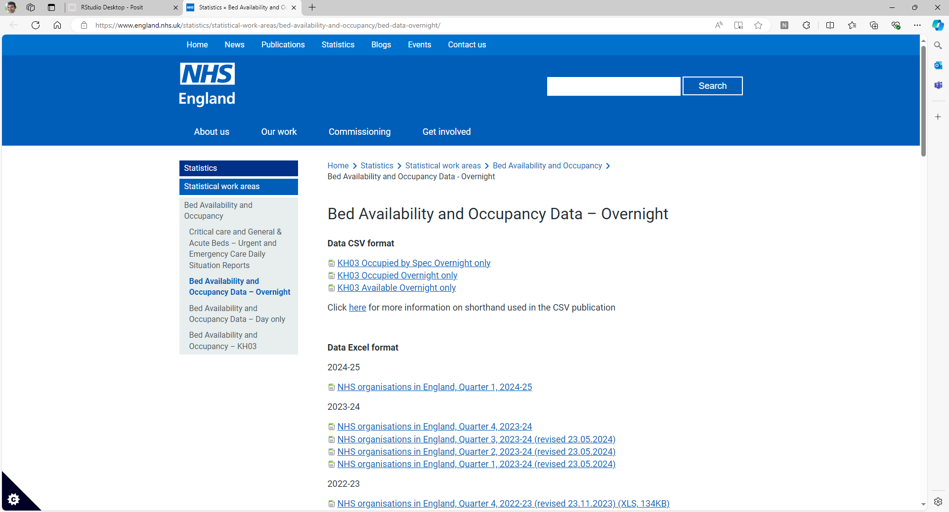
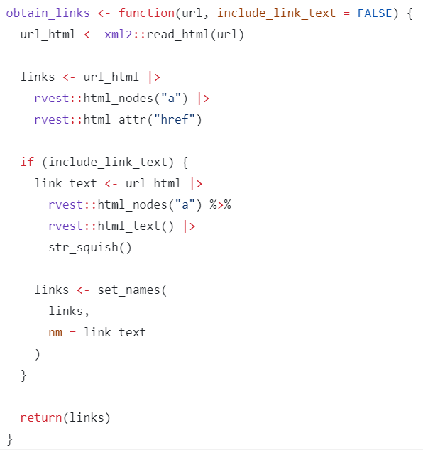
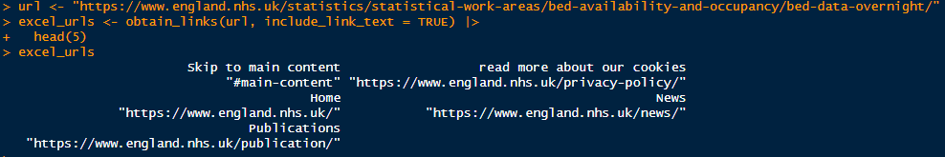
Obtaining data
Reproducibility
Programmatically scraping data
Data
Methods
Implementation

Slide 13
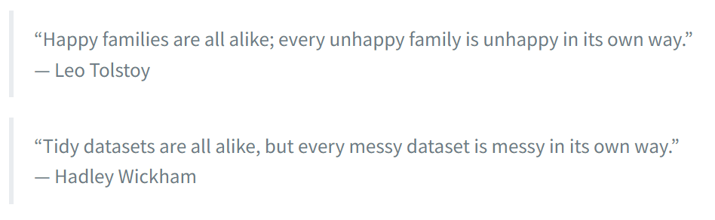
Tidying data
Reproducibility
Some public data is “tidy” (link to paper on tidy data, and a practical example)
Each variable is a column; each column is a variable.
Each observation is a row; each row is an observation.
Each value is a cell; each cell is a single value.
Data
Methods
Implementation
“Is every row self-sufficient? Could I read only one row and understand all the data in it?” – Source: {unpivotr} vignette

Slide 14
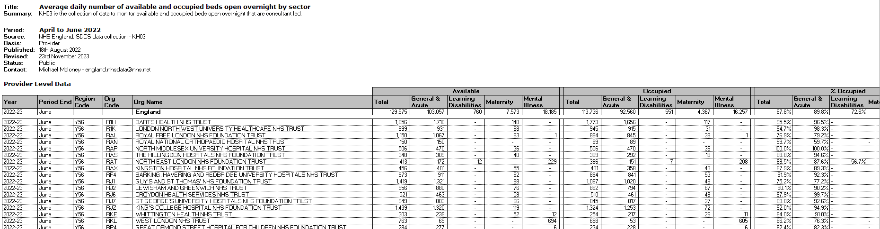
Messy data
Reproducibility
Merged cells
Blank rows and columns
Information about the sheet
Multiple tabs of data
Data
Methods
Implementation

Slide 15
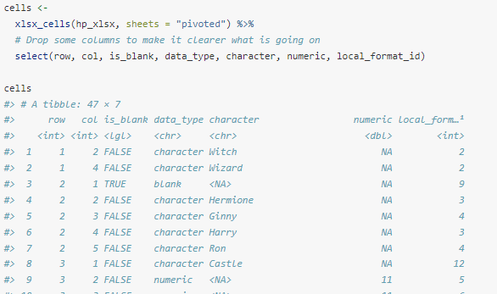
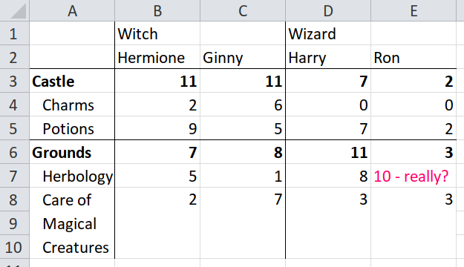
Tidying messy data tidyxl::xlsx_cells()
Reproducibility
Data
Methods
Implementation
Source: unpivotr vignette (https://cran.r-project.org/web/packages/unpivotr/vignettes/introduction.html)

Slide 16
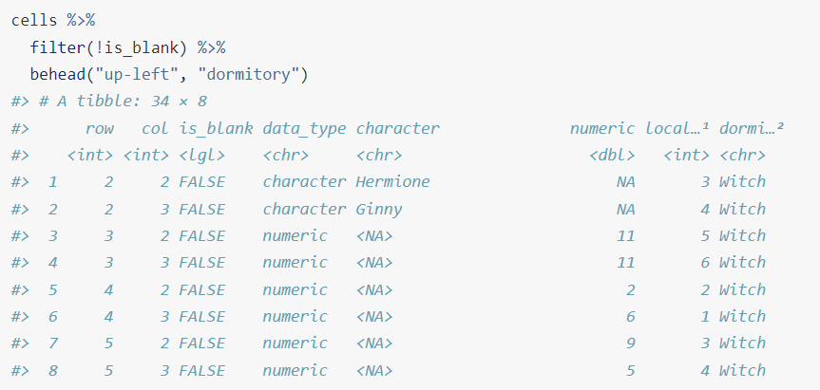
Tidying messy data unpivotr::behead()
Reproducibility
Data
Methods
Implementation
Source: unpivotr vignette (https://cran.r-project.org/web/packages/unpivotr/vignettes/introduction.html)

Slide 17
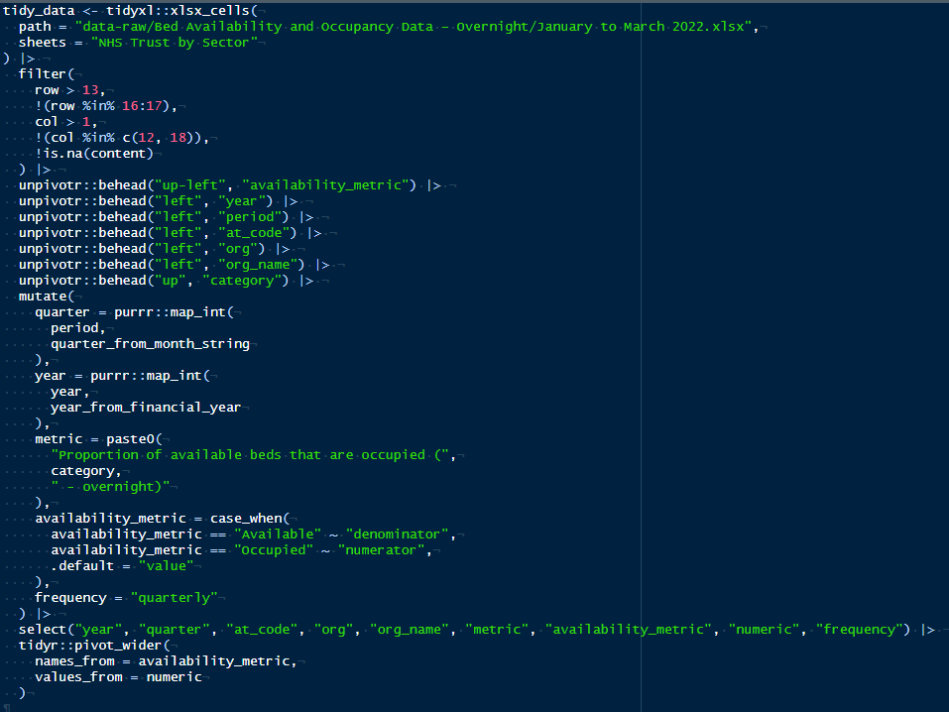
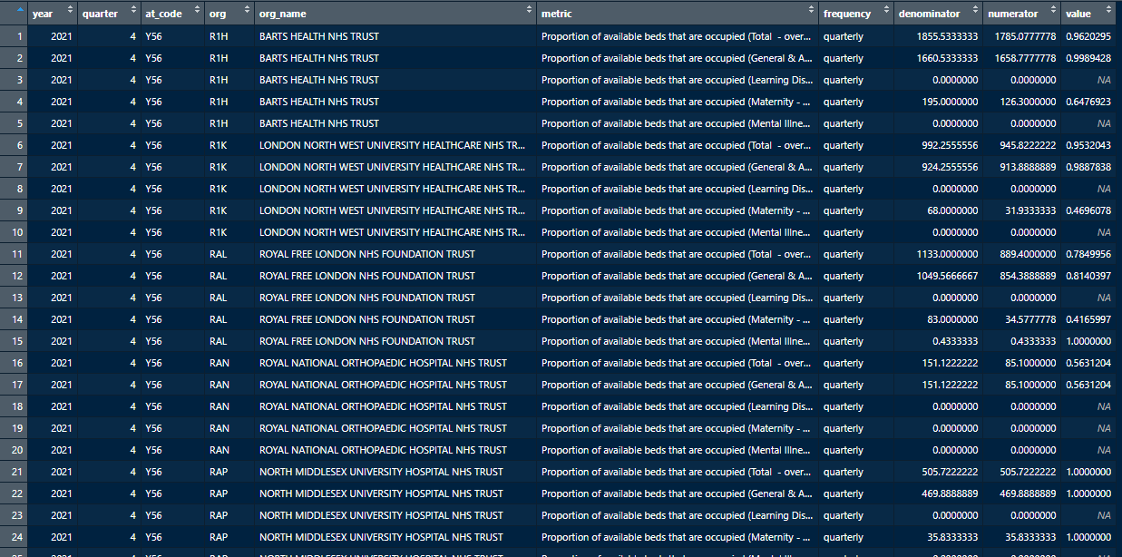
Tidy bed data
Reproducibility
Data
Methods
Implementation

Slide 18
Final dataset - inputs
Reproducibility
Demand metrics:
Population by age
Smoking/obesity prevalence (including child obesity)
Condition prevalence (Atrial Fibrillation, Hypertension, Learning Disabilities (LD), Mental Health)
Capacity metrics:
Bed availability (day/night – General & Acute, LD/Maternity/Mental Illness)
Number of beds (General & Acute/LD/Maternity/Mental Illness)
Staff absence and availability (acute and mental health)
Expenditure on mental health
Workforce full time equivalents (acute, A&E, and primary care for different staff categories)
COVID-19 pressures
Data
Methods
Implementation

Slide 19
Final dataset - outputs
Reproducibility
Performance metrics (the “outcome”):
Wait of 62 or greater days from suspected cancer or referral to first definitive treatment
Accident & Emergency attendances greater than four hours at Type 1 Departments, major A&E
Attended primary care appointments with over a four-week waiting time
Incomplete referral to treatment pathways with a greater than 18 and 52 weeks since referral
Data
Methods
Implementation

Slide 20
Methods
Reproducibility
Lots of modelling approaches attempted
Inputs to modelling | Description
Number of years of data | 3 to 7 years
Number of lagged years for predictor variables | 0, 1, or 2 lagged years
Inclusion of previous year’s value for target variable | True or false
Number of target variables modelled | 5
Modelling methods explored | Generalised linear models Random forest (on outcome and on change in outcome) Linear extrapolation Same as previous year
Data
Methods
Implementation

Slide 21
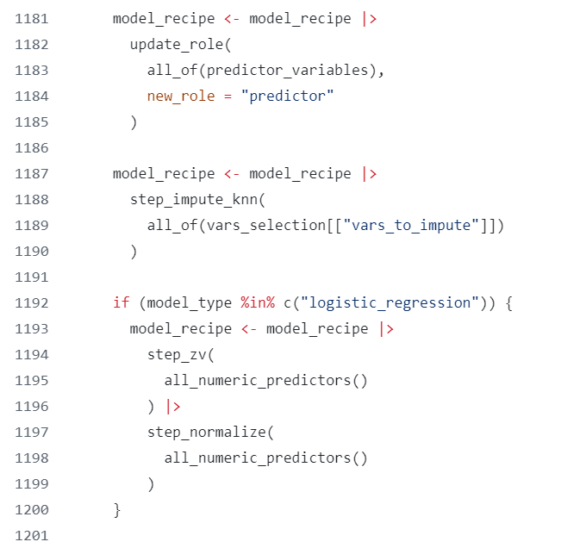
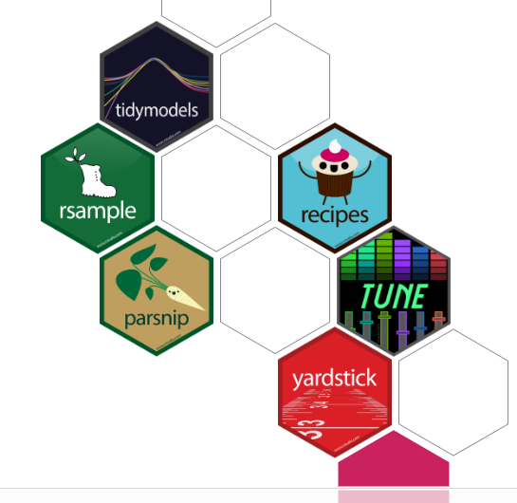
Using {tidymodels}
Reproducibility
Data
Methods
Implementation

Slide 22
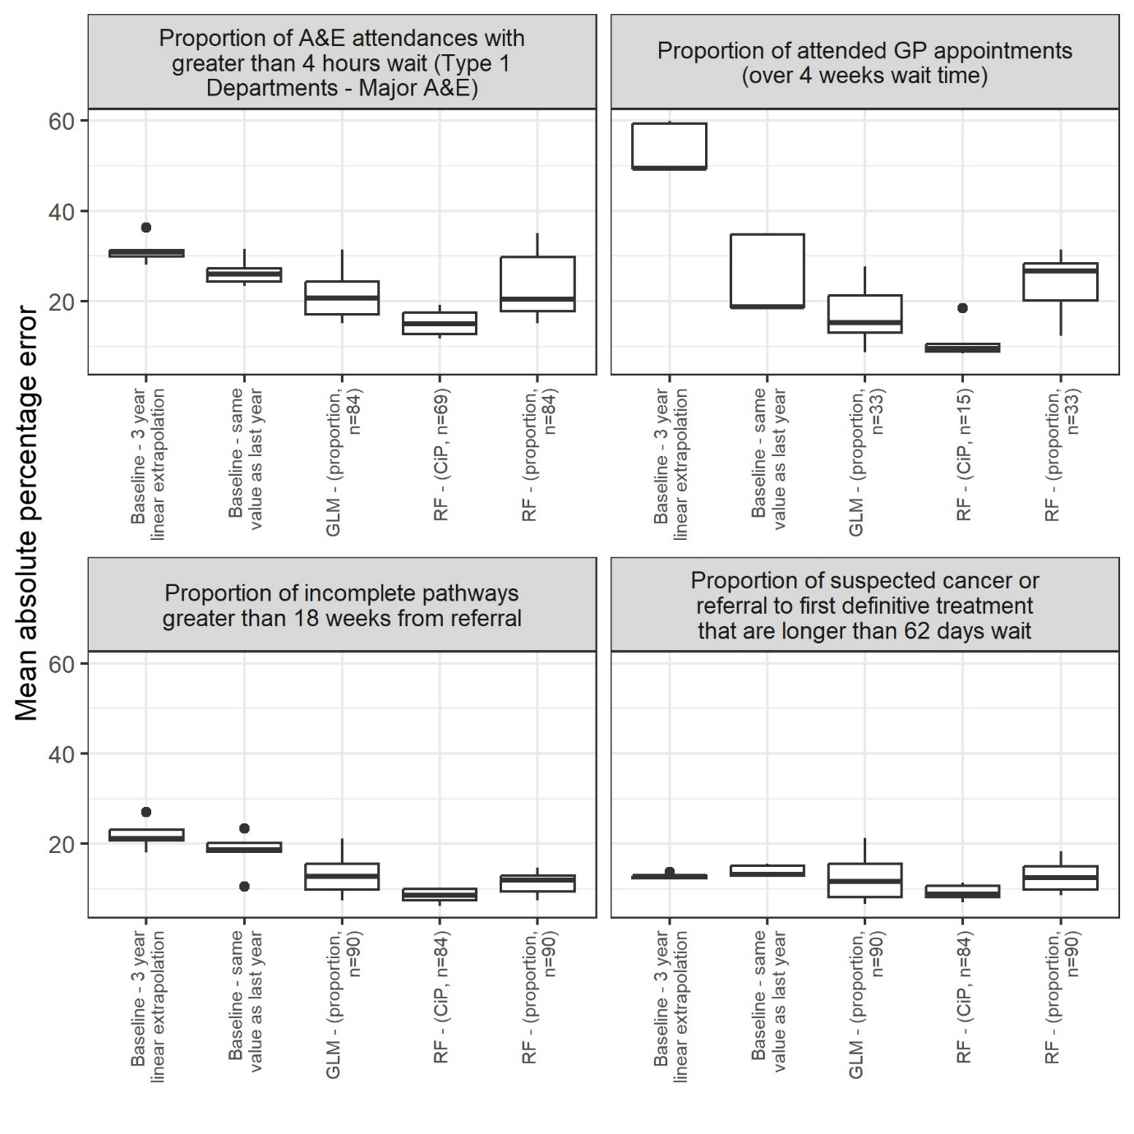
Model evaluation
Reproducibility
Sophisticated models generally outperformed naïve models
Random forest model, that modelled the change in outcome from one year to the next, generally performed best
A&E 4 hr waits had the highest mean absolute percentage error
Data
Methods
Implementation

Slide 23
Implementation
Reproducibility
RShiny
{golem}
shinyapps.io
Data
Methods
Implementation

Slide 24
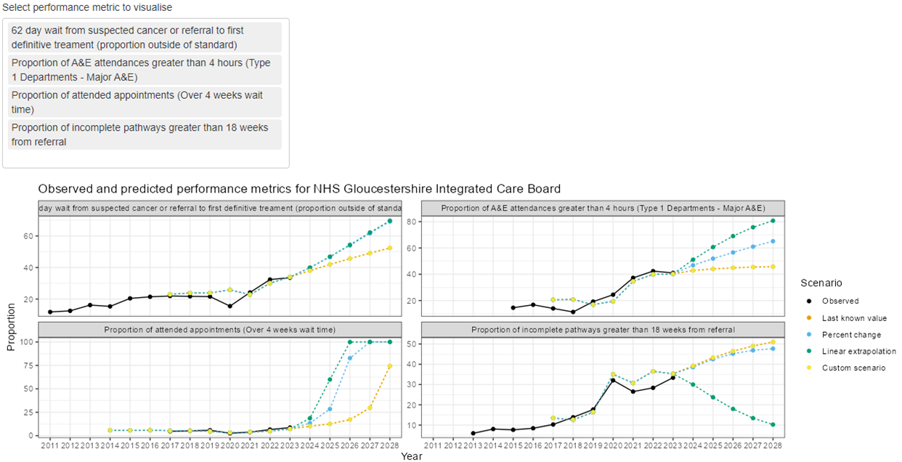
RShiny
Reproducibility
Customisable
Can take my R outputs from the analysis as inputs
Data
Methods
Implementation

Slide 25
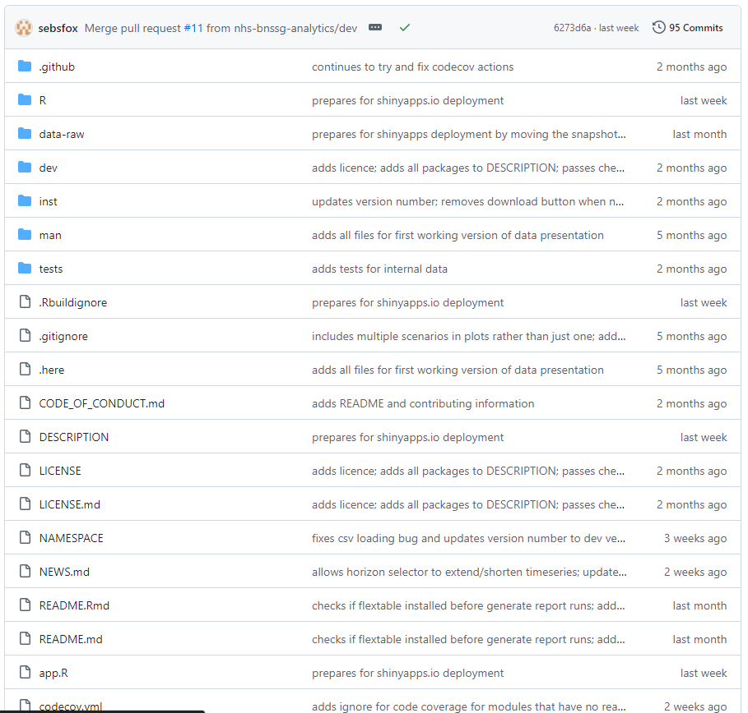
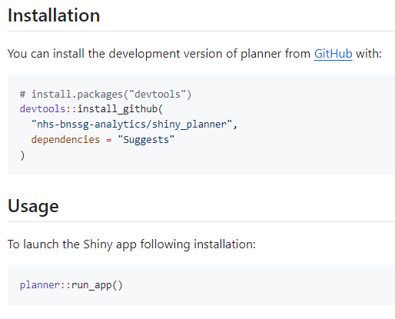
{golem}
Reproducibility
Modular
Standard project structure
Unit testing
Easily installable
Continuous integration
Data
Methods
Implementation

Slide 26
shinyapps.io
Reproducibility
Free (with big limitations)
Publically available (this is ok because it uses public data)
Easy to set up
Url: https://sw-dsn.shinyapps.io/planner/
Data
Methods
Implementation

Slide 27
Thank you
Reproducibility
Data
Methods
Implementation

